Slide 1
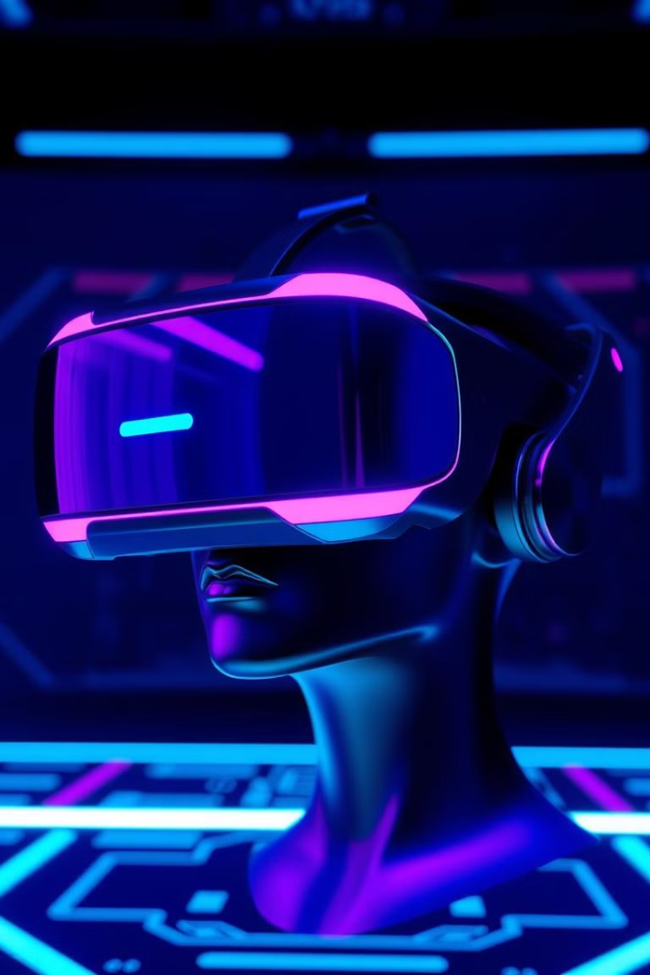


Welcome to the VR Career Explorer!
Welcome to the Virtual Reality Career Explorer, your guide to the exciting world of VR careers! This presentation will provide insights into the rapidly growing VR/AR market, which is projected to reach $454.73 billion by 2030, according to Statista. We will explore various roles, essential skills, and pathways to success in this innovative field. Get ready to discover your future in the immersive world of Virtual Reality!
by SHARDUL THAKUR

Slide 2

What is Virtual Reality and Why Now?
Defining VR, AR, and MR
Market Growth Drivers
Virtual Reality (VR) creates fully immersive digital environments, Augmented Reality (AR) overlays digital information onto the real world, and Mixed Reality (MR) blends VR and AR to enable interactions between real and virtual objects. Understanding these differences is crucial for navigating the VR career landscape.
The VR/AR market is experiencing rapid growth, driven by applications in gaming, healthcare, education, and training. Gaming provides immersive entertainment, while healthcare uses VR for surgical simulations. Education benefits from immersive learning experiences, and corporate training utilizes VR for simulations. VR headset shipments are projected to reach 50.74 million units worldwide by 2028, according to Statista.

Slide 3





Key VR Career Paths: Design & Development
VR Designer
VR Developer
Meta requires proficiency in C++ and experience with the Oculus SDK.
VR Designers create immersive experiences and focus on UX/UI design, 3D modeling, storytelling, and user research. They utilize tools like Unity, Unreal Engine, Blender, and Maya. The average salary for a VR Designer is $78,000 per year.
VR Developers build the technical backbone of VR experiences, requiring skills in C#, C++, Java, scripting, and software engineering. They use tools like Unity, Unreal Engine, and VR SDKs (Oculus, SteamVR). The average salary for a VR Developer is $92,000 per year.

Slide 4



Key VR Career Paths: Art, Audio & Management
3D Artist
3D Artists model and texture virtual environments, utilizing skills in 3D modeling, texturing, lighting, animation, and sculpting. Tools include Blender, Maya, ZBrush, and Substance Painter. The average salary is $65,000 per year.
VR Audio Engineer
VR Audio Engineers create immersive soundscapes, requiring skills in sound design, spatial audio, recording, mixing, and mastering. They use tools like FMOD, Wwise, Unity, and Unreal Engine. The average salary is $72,000 per year.
VR Project Manager
VR Project Managers oversee VR projects from concept to launch, with skills in Agile/Scrum, communication, leadership, and risk management. Certifications include PMP and Certified ScrumMaster (CSM). The average salary is $85,000 per year.

Slide 5





The VR Ecosystem: Companies & Industries
Gaming
VR is revolutionizing gameplay with titles like Beat Saber and Half-Life: Alyx. The gaming sector generated $11.5B in revenue in 2023, according to Newzoo.
Healthcare
VR is used for training, therapy, and surgical simulations, as seen in Osso VR. The market is projected to reach $30.4B by 2030, according to Global Market Insights.
Education
VR provides immersive learning experiences, exemplified by Labster. The market is expected to grow by a 21.7% CAGR from 2024-2032, as per Polaris Market Research.
Training
VR is used for corporate training and simulations, such as STRIVR. This reduces training costs by up to 40%, according to a PwC study.

Slide 6
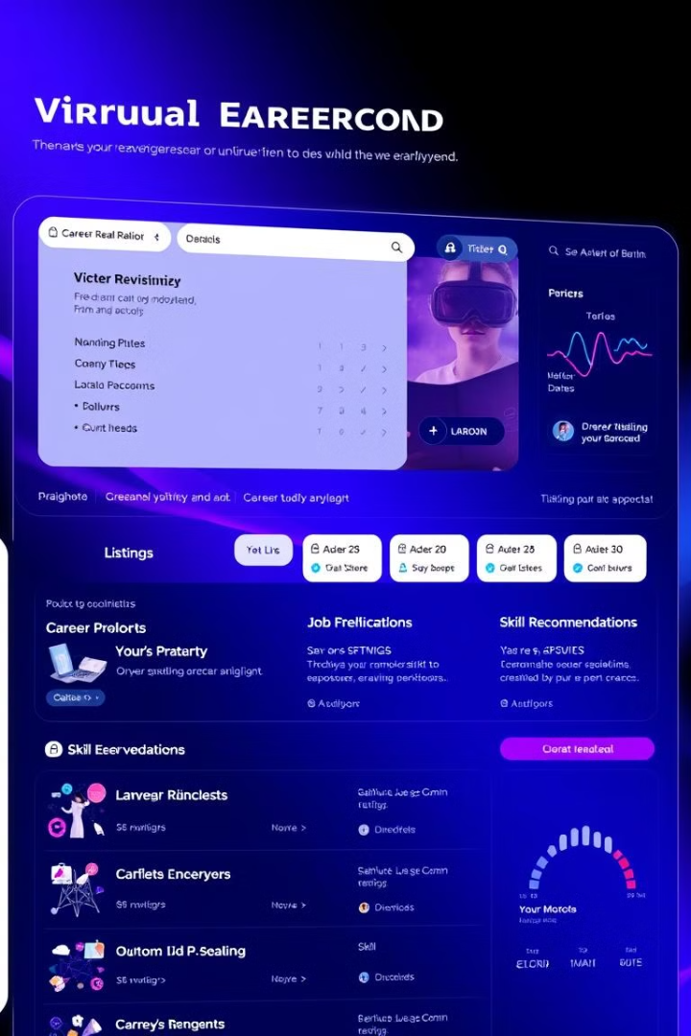
Introducing the VR Career Explorer Tool
Interactive Platform
Discover VR career options with our interactive platform.
Personalized Recommendations
Get personalized recommendations based on your skills and interests.
Real-time Data
Access real-time job market data and salary insights.
Learning Resources
Find learning resources and training programs.

Slide 7
Example: Using the VR Career Explorer
Scenario 1: UX Designer
Scenario 2: Software Engineer
A UX designer interested in VR can explore needed skills and available jobs. The tool provides a skills gap analysis, recommending 3D modeling courses and lists 15+ junior VR designer roles at companies like Accenture and Unity.
A software engineer looking to transition to VR development can get suggestions to focus on Unity and C# training. It also highlights projects using VR for construction training, providing clear pathways for career transition.

Slide 8




Your VR Future Starts Now!
Explore the VR Career Explorer
Take the Skills Assessment
Connect with Professionals
Start your journey today by exploring our comprehensive tool.
Find your perfect path by taking our detailed skills assessment.
Network with VR professionals and communities to expand your opportunities.

